Slide 1
EMPLOYEE LOGIN
PARK MEDICLAIM INSURANCE TPA PVT LTD

Slide 2
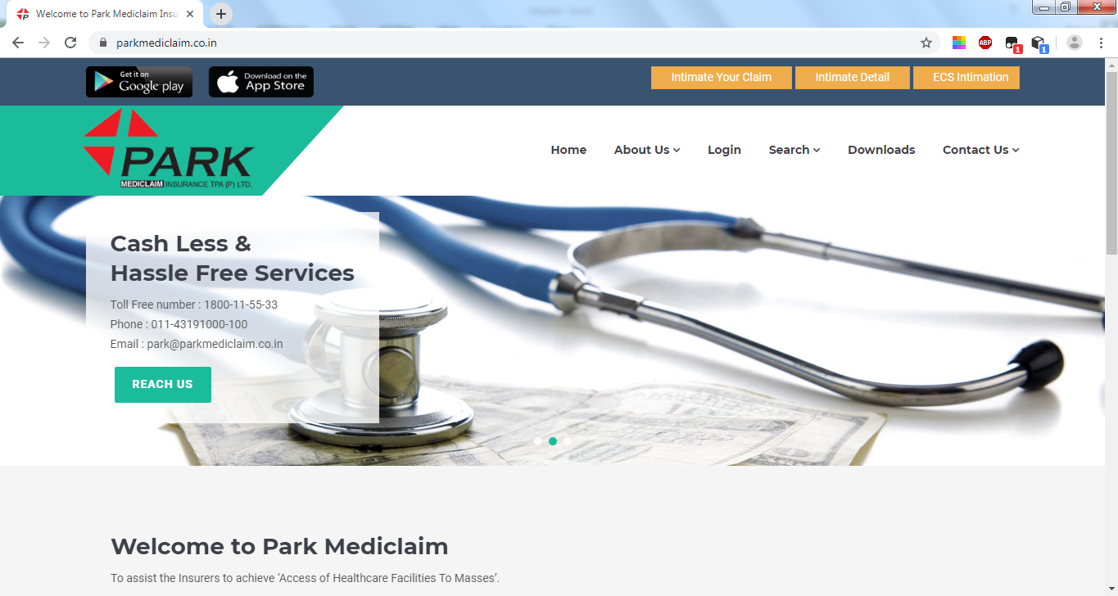
STEP 1 : GO TO PARK MEDICLAIM TPA WEBSITE (https://www.parkmediclaim.co.in/)

Slide 3
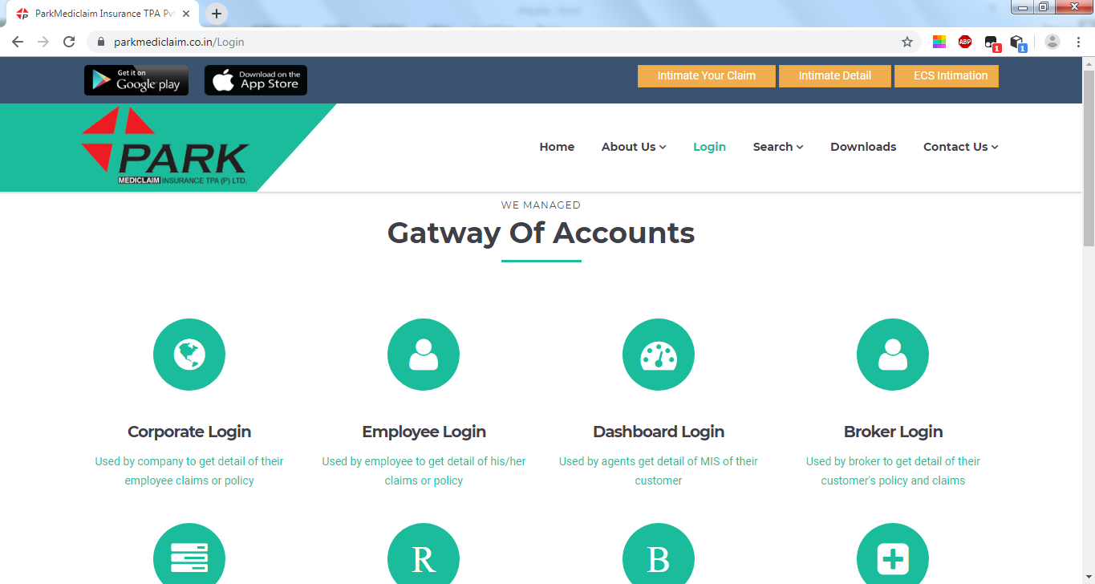
STEP 2 : CLICK ON LOGIN BUTTON. IN LOGIN BOTH CORPORATE & EMPLOYEE LOGIN FACILITIES ARE AVAILABLE.

Slide 4
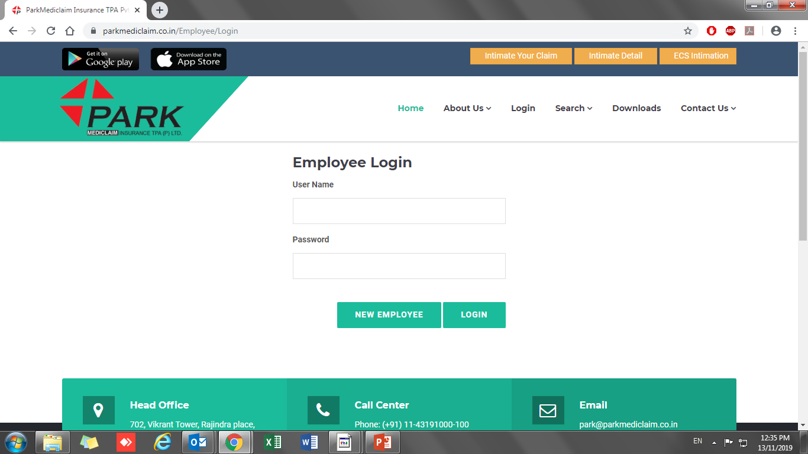
STEP 3 : AFTER LOGGING IN TO EMPLOYEE LOGIN, CLICK ON NEW EMPLOYEE.

Slide 5
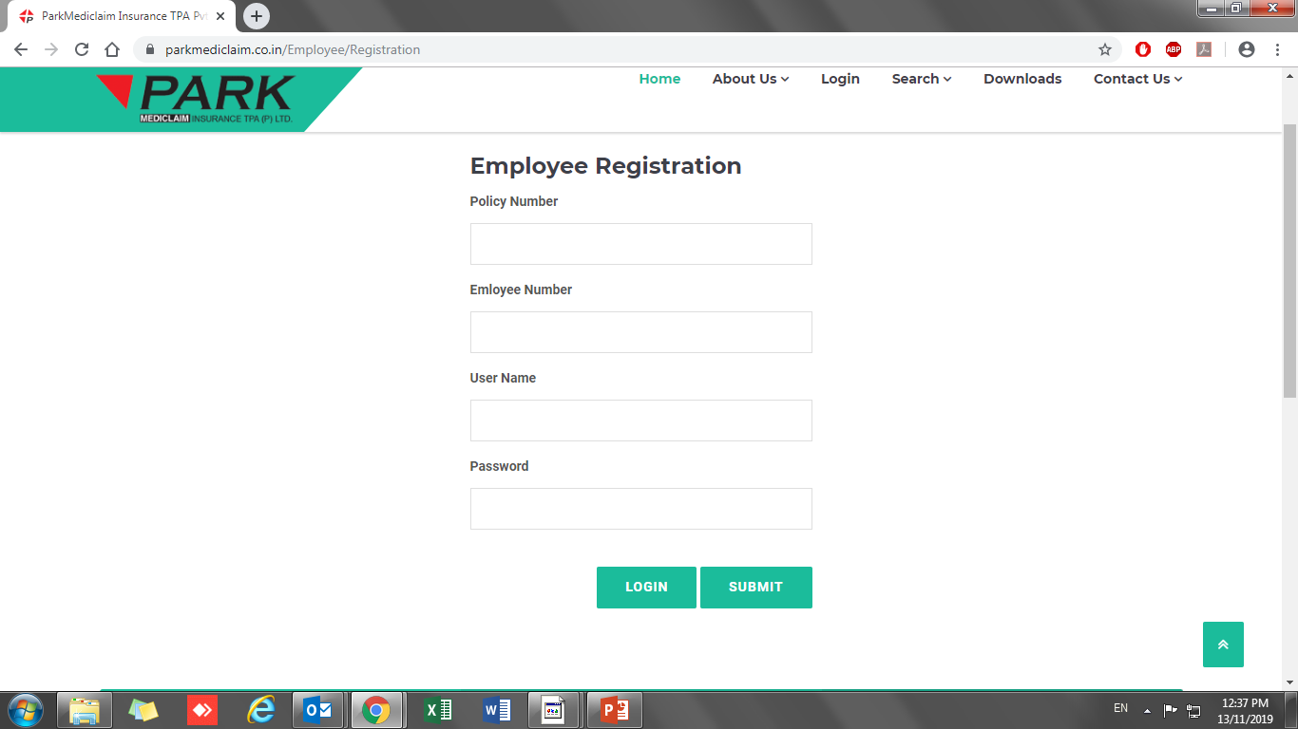
STEP 4 : MENTION YOUR POLICY NUMBER & EMPLOYEE NUMBER AND CREATE A NEW USERNAME AND PASSWORD AS PER YOUR REQUIREMENT.

Slide 6
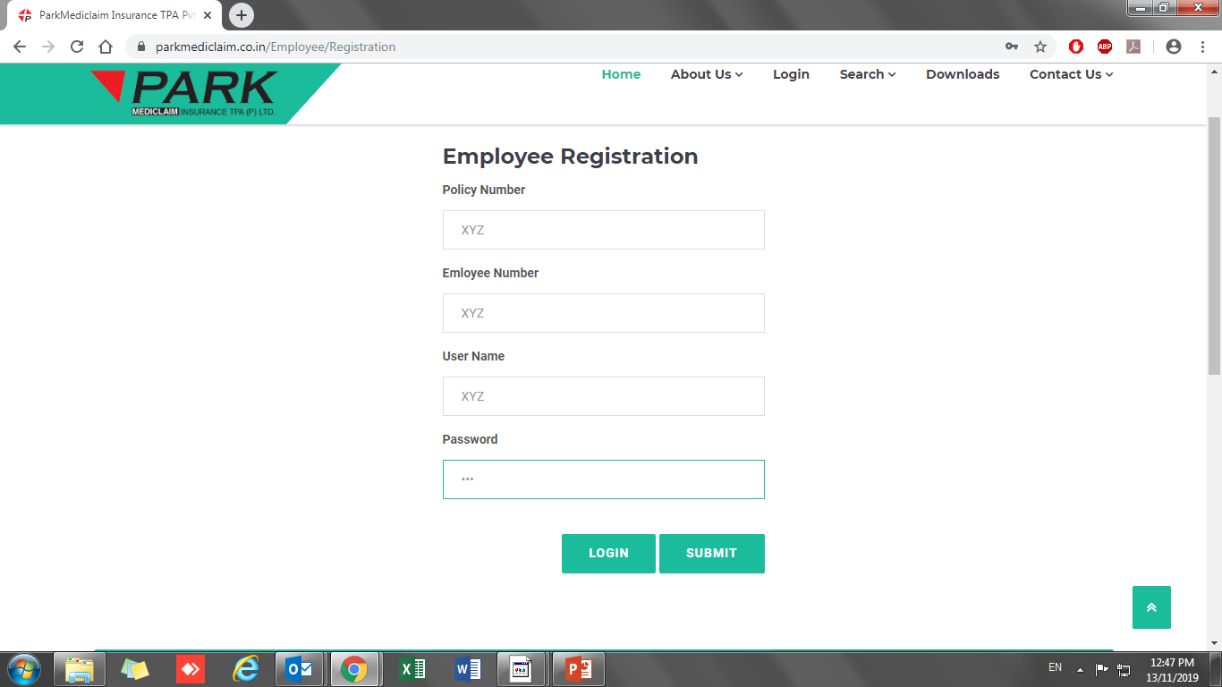
STEP 5 : CLICK ON SUBMIT

Slide 7
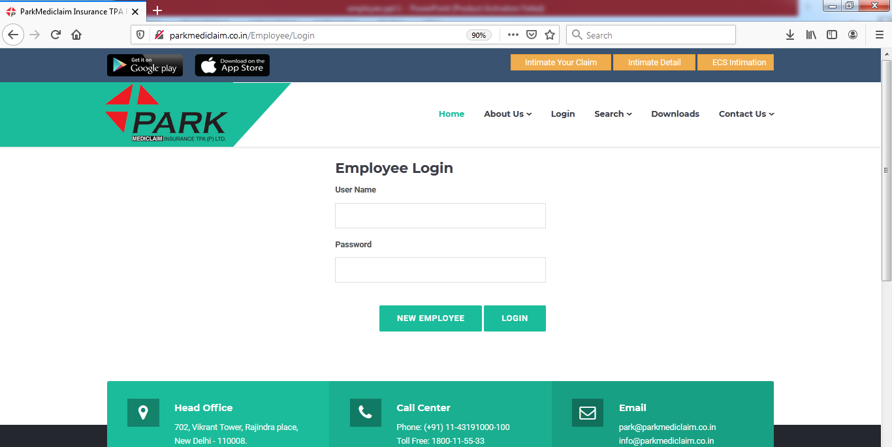
STEP 6 : AFTER SUBMITTING ALL THE DETAILS, YOU WILL AGAIN REDIRECT TO EMPLOYEE LOGIN TAB. NOW, ENTER THE CREATED USERNAME & PASSWORD AND CLICK ON LOGIN.

Slide 8
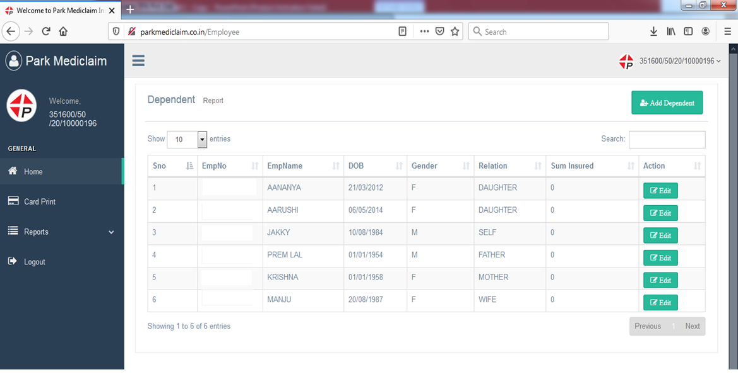
STEP 7 : AS YOU ENTER IN EMPLOYEE LOGIN, THE EMPLOYEE PANEL WILL SHOW THE FAMILY DETAILS AND ACCESS TO CARD PRINTING AND CLAIM INTIMATION REPORT FOR CHECKING CLAIMS STATUS.

Slide 9
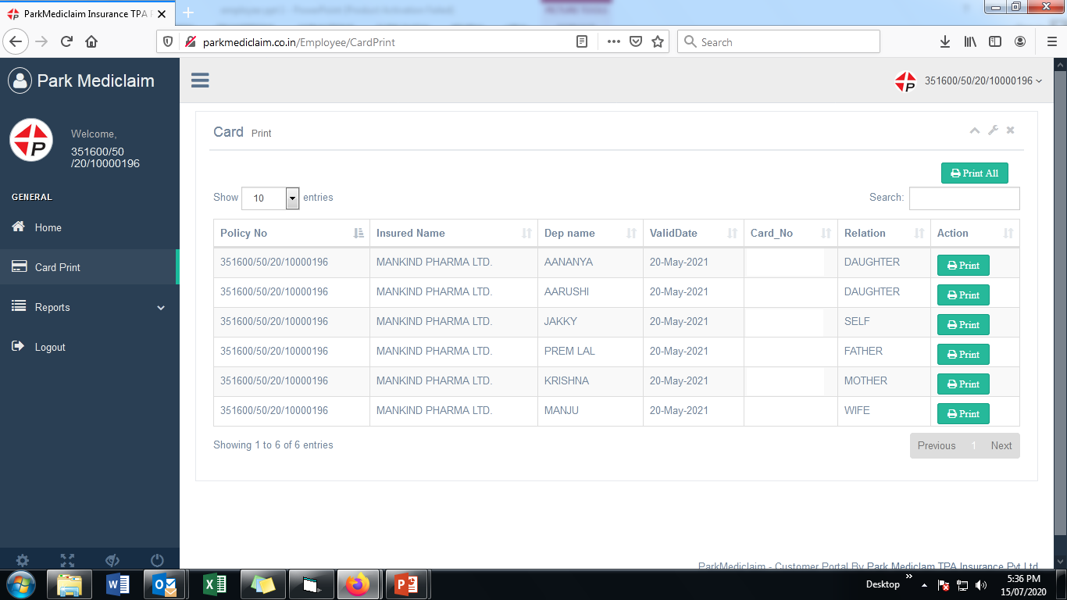
STEP 8 : EMPLOYEE CAN PRINT CARDSCLICKING ON PRINT OR PRINT ALL.

Slide 10
THANK YOU

